Slide 1
AIRLINE SAFETY
Do past accidents predict future safety?
Applied Data Mining—Final Project
Q. Herron | 8 May 2017

Slide 2
The Question
“Can we use data on an airline’s history of incidents and fatal accidents in one time period to predict its safety in the next?”

Slide 3
The Hypothesis
H₀: There is no link between past incidents and current safety.
H₁: Past incidents can predict current airline safety.

Slide 4
The Data
Data source: fivethirtyeight (R package)—airline_safety dataset
Observations on 56 airlines
Data for two 15-year periods (1985-1999 and 2000—2014)
Total incidents, fatal accidents, and number of fatalities
Available Seat-Kilometers (ASK), weekly average
Distance Flown times Seats Available
Indicator of airline size

Slide 5

Data Preparation
Objective—Make all airlines and their figures easily comparable
Solution—Express the safety figures “per trillion ASK”
Method—Adjustment factor = $\frac{1,000,000,000}{Avail. Seat KM}$. Then multiply each safety figure by the adjustment factor.

Slide 6
Adjustment: Example

Slide 7
Cluster Analysis
Objective—Sort airlines into clusters based on safety records
Solution—Use k-Medoids to find best-fit clusters

Slide 8
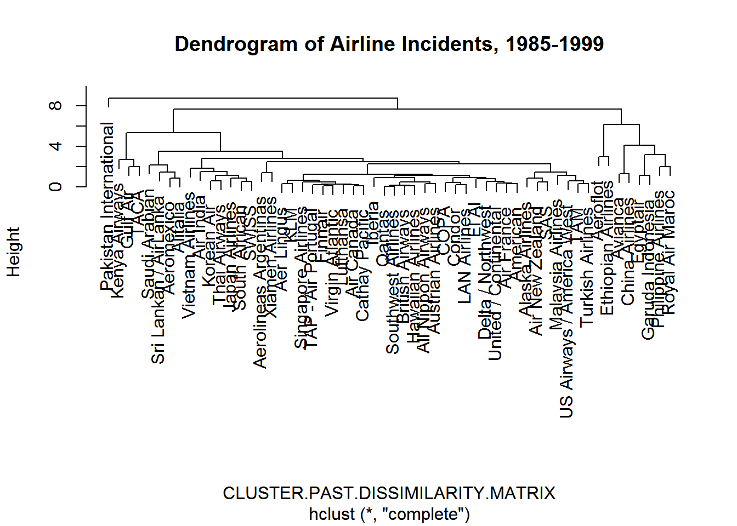
Cluster Analysis
Dendrogram—Shows how clusters are formed.
Left side—”safer” airlines
Right side—”riskier” airlines

Slide 9
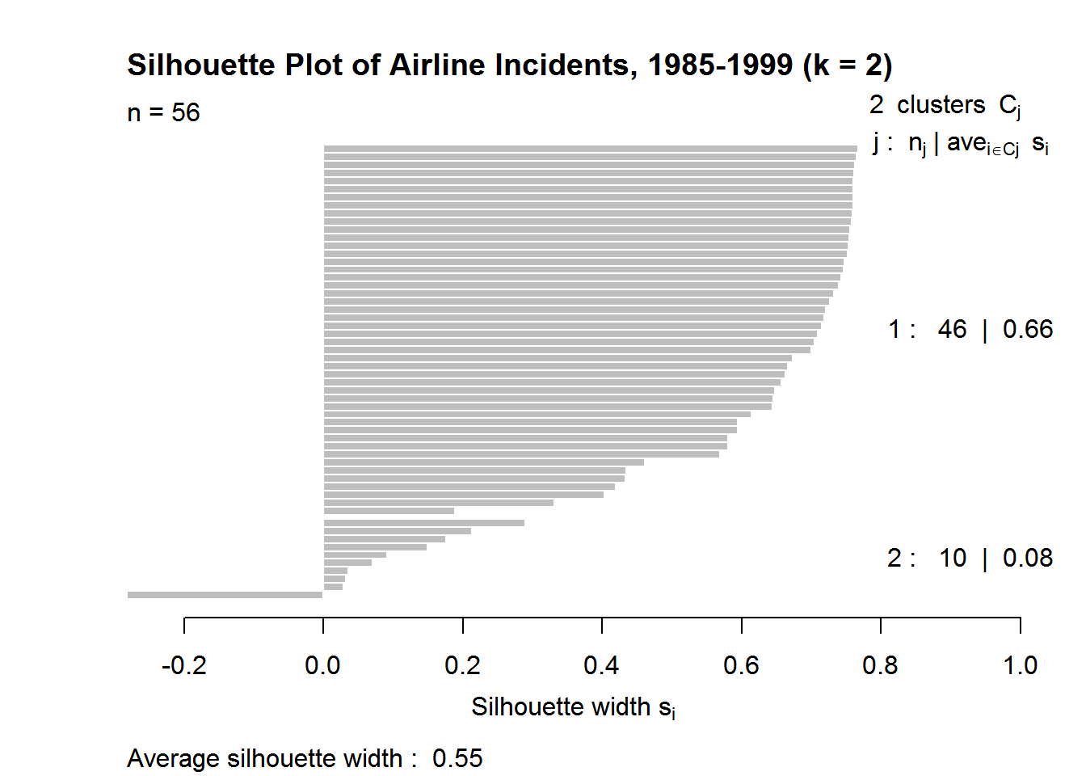
Cluster Analysis
Silhouette plot—Shows each observation as a line. The width of the line shows how well an observation fits into its cluster.
Top cluster—”safer” airlines
Bottom cluster—”riskier” airlines

Slide 10
Cluster Analysis
1985—1999
Aeroflot (Russia)
Avianca (Colombia)
China Airlines
Egyptair
Ethiopian Airlines
Garuda Indonesia
Pakistan International
Philippine Airlines
Royal Air Maroc (Morocco)
Saudi Arabian
2000-2014
Aeroflot (Russia)
Avianca (Colombia)
China Airlines
Egyptair
Ethiopian Airlines
Garuda Indonesia
Pakistan International
Philippine Airlines
Royal Air Maroc (Morocco)
TACA (Avianca El Salvador)
Vietnam Airlines
Xiamen Airlines

Slide 11
Cluster Analysis: Results
“Risky” clusters are very similar between time periods
However, these were two independent clusters
Doesn’t necessarily imply a correlation

Slide 12
Logistic Regression
Objective—Predict “risky” airlines today based on past performance
Solution—Define a “risky” airline, and fit a logistic regression model

Slide 13
Logistic Regression
Create a target variable—We will define “risky” as follows:
Ten or more fatalities per trillion ASK, between 2000 and 2014
This can be user-specified as desired
Should not be too restrictive (Need 25-50% positive class)
In the real world, this “risk” is about on par with your odds of
winning the Powerball jackpot.

Slide 14
Logistic Regression: Results
No Significance—Past variables were not good predictors
p-values from 0.12 to 0.45 (p < 0.05 is significant)
Confusion Matrix—Risk = TRUE
Correctly predicted all “non-risky” airlines
But only 33% effective for picking “risky”

Slide 15
BAGGING
Objective—Prove whether or not past data can predict risk
Solution—Use bootstrap aggregating (“bagging”), a complex ensemble model approach

Slide 16
BAGGING
Method—Run random forest models on multiple subsets of the data. “Majority vote” determines each prediction.
Out-of-Bag Error—An estimate of how often the model will fail to predict correctly
OOB Error estimate is 40%—not looking good

Slide 17
BAGGING: Results
Confusion Matrix—Risk = TRUE
Sensitivity (true prediction) has improved (67%)
Specificity (false prediction) dropped to 50%
Overall Accuracy is 56%
Kappa Statistic
Kappa adjusts Accuracy to account for predictions due to chance.
Value of 0.15 suggests that 85% of correct prediction is the result of luck.

Slide 18
Conclusion
Clustering suggested a potential link
Most of the same airlines in both “risky” clusters
Airlines of poorer countries more dangerous? Look at GDP per capita.
Regression failed to support a significant link
Bagging proved no substantial link was present in the data
Kappa—most of the correct predictions were due to random chance.

Slide 19
Conclusion
H₀: There is no link between past incidents and current safety.
We fail to reject the null hypothesis.
Not enough evidence to prove any significant correlation.
Inaccurate and unfair to arbitrarily label some airlines—especially “third-world” airlines—as more risky.
An airline’s current safety cannot be reasonably predicted by past incidents and accidents.
Source: https://fivethirtyeight.com/features/should-travelers-avoid-flying-airlines-that-have-had-crashes-in-the-past/

